Slide 1
LEARNING MANAGEMENT SYSTEM
BY ASHWIN KRISHNA V

Slide 2
PROBLEM STATEMENT
Create and manage courses.
Allow students to enroll in available courses.
Track and update student learning progress.
Provide quiz questions for each course.
Allow students to submit quiz answers and record scores.
Provide REST APIs for communication between the frontend and backend.
Store course, enrollment, progress, quiz, and score information in a database.
单击此处编辑母版文本样式
二级
三级
四级
五级

Slide 3
OBJECTIVES
Course Management – Add and view courses.
Course Enrollment – Students can enroll in courses.
Progress Tracking – Students can track their learning progress.
Quiz Management – Students can attend quizzes and submit scores.
Data Storage – Store course, student, progress, and quiz information.
Frontend–Backend Communication – React communicates with Spring Boot through REST APIs.
单击此处编辑母版文本样式
二级
三级
四级
五级

Slide 4
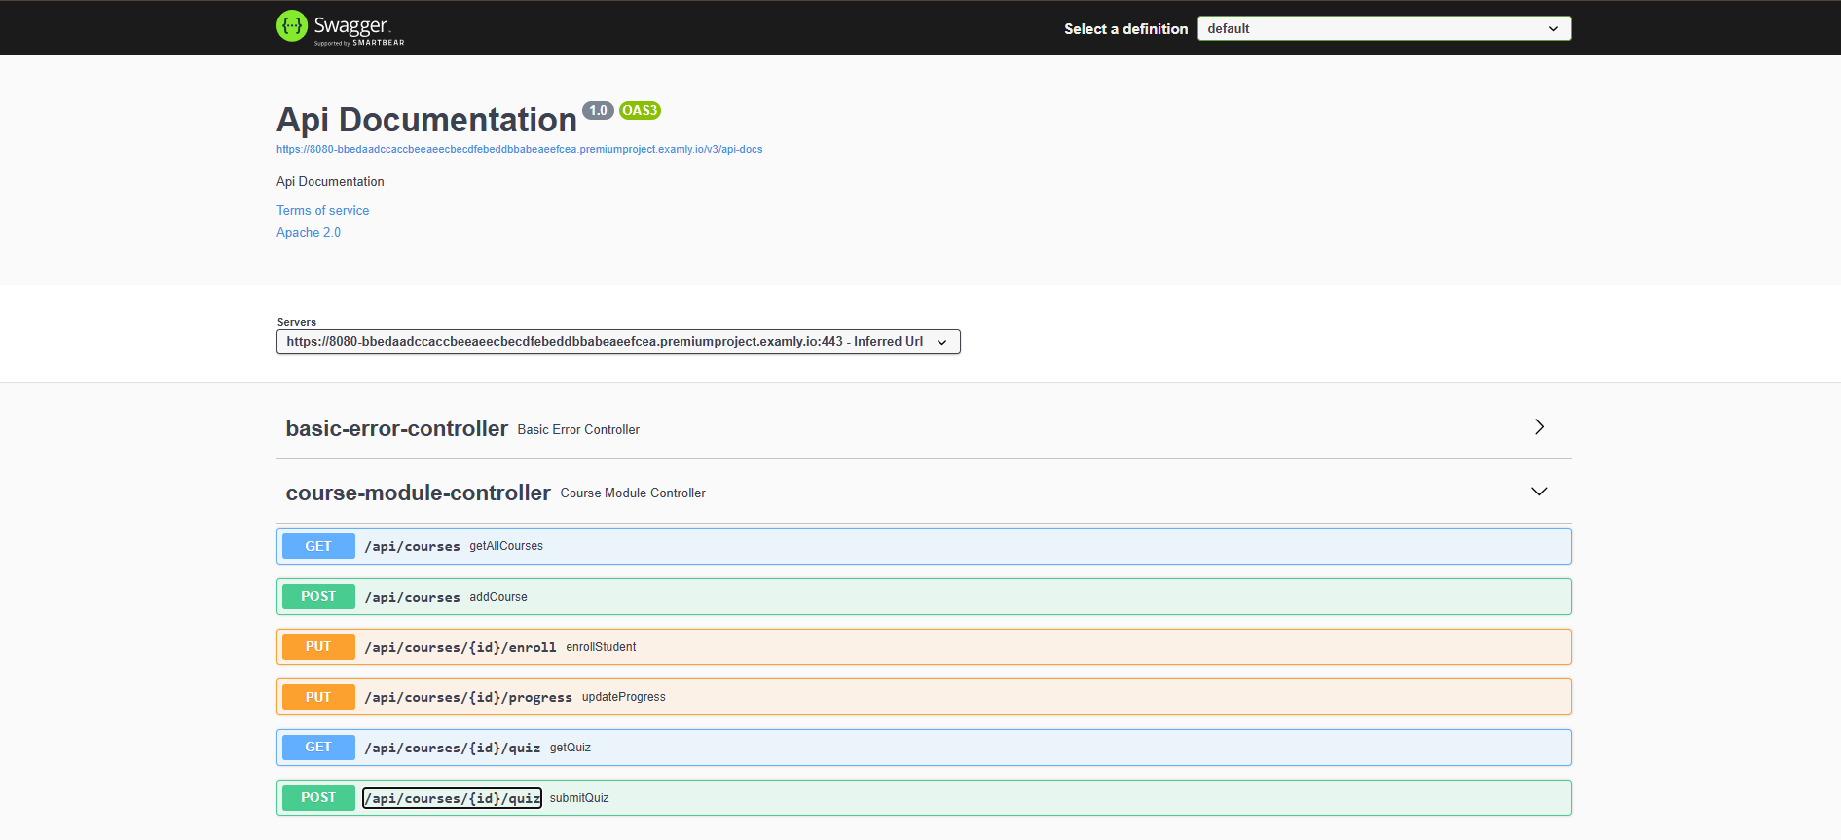
REVIEW 1 RECAP

Slide 5
TECHNOLOGY STACK
``
React.js | Build the user interface
JavaScript | Application logic
HTML5 & CSS3 | Structure and styling
React Router | Page navigation
Axios | Communication with backend REST APIs
React Hooks | useState, useEffect, useNavigate

Slide 6
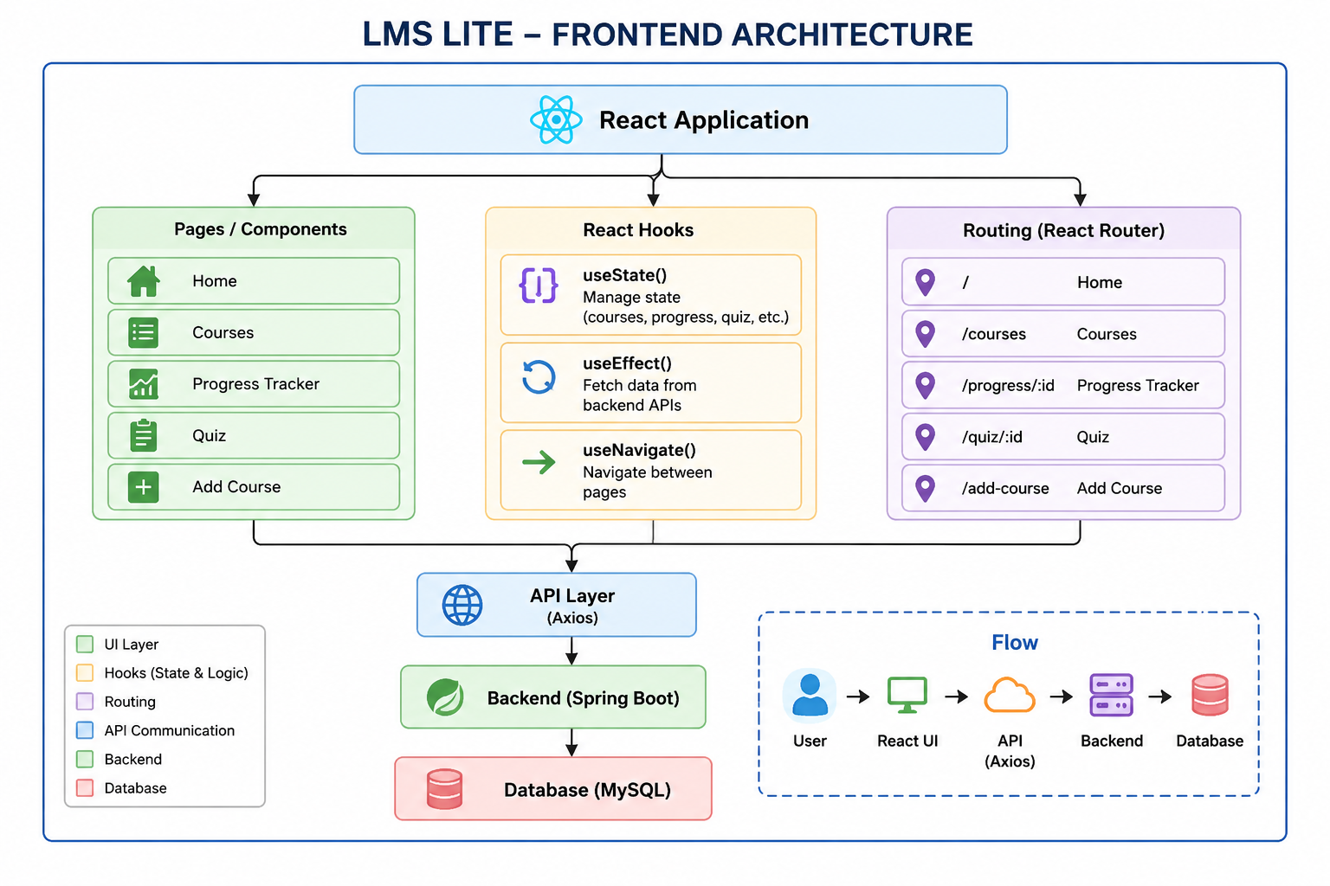

Slide 7
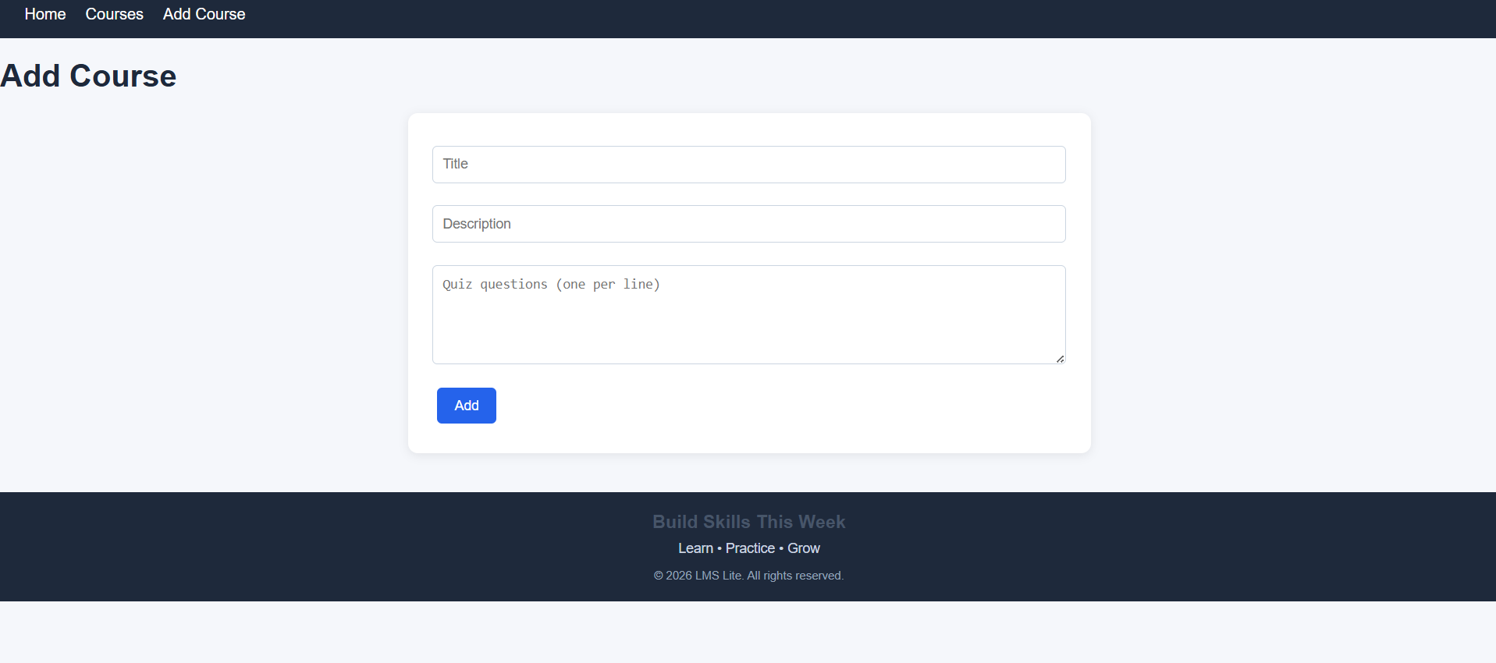
ADDING A COURSE

Slide 8
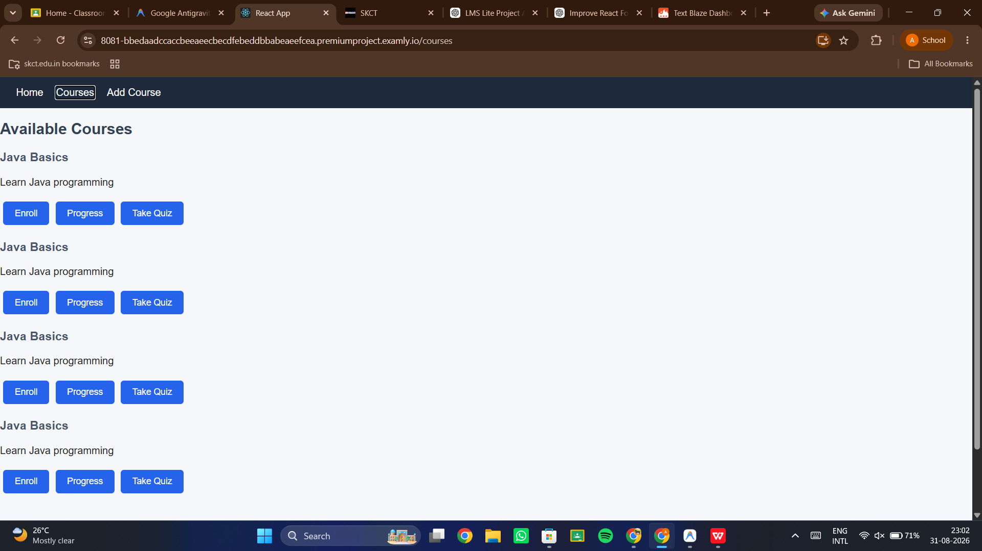
LIST OF COURSES

Slide 9
CONCLUSION
Developed a simple Learning Management System (LMS).
Users can view and add courses.
Users can enroll in courses and track progress.
Users can attend quizzes and view scores.
React is used for the frontend.
Spring Boot and MySQL are used for backend and data storage.
The project makes course management simple and easy.

Slide 10
THANK YOU
BY ASHWIN KRISHNA V

